Slide 1


Simulations of Electron Detection Systematic Errors for the UCNA+ Experiment
"Science is not static but is dynamic and ever-improving. It is the courage to doubt what has long been believed and the incessant search for verification and proof that pushes the wheels of science forward.“ - Madame Wu
Rashika Gupta
University of Kentucky
October 30, 22

Slide 2
OUTLINE
Neutron – beta decay : Angular Correlations
Measurement of A from UCNA
UCNA+ simulation result for backscattering systematics
Move detector in the field expansion region
Different thin foil configurations
using neutron beta decay and electron conversion from ¹¹³Sn
Notes:
Change in fraction of back-scattering and angle and energy dependence
“initial and secondary detector energy spectra, time offlight, time of flight versus mean energy, total energy, and total fraction can all be extracted from the dataand used to benchmark the performance of the Monte Carlo”

Slide 3
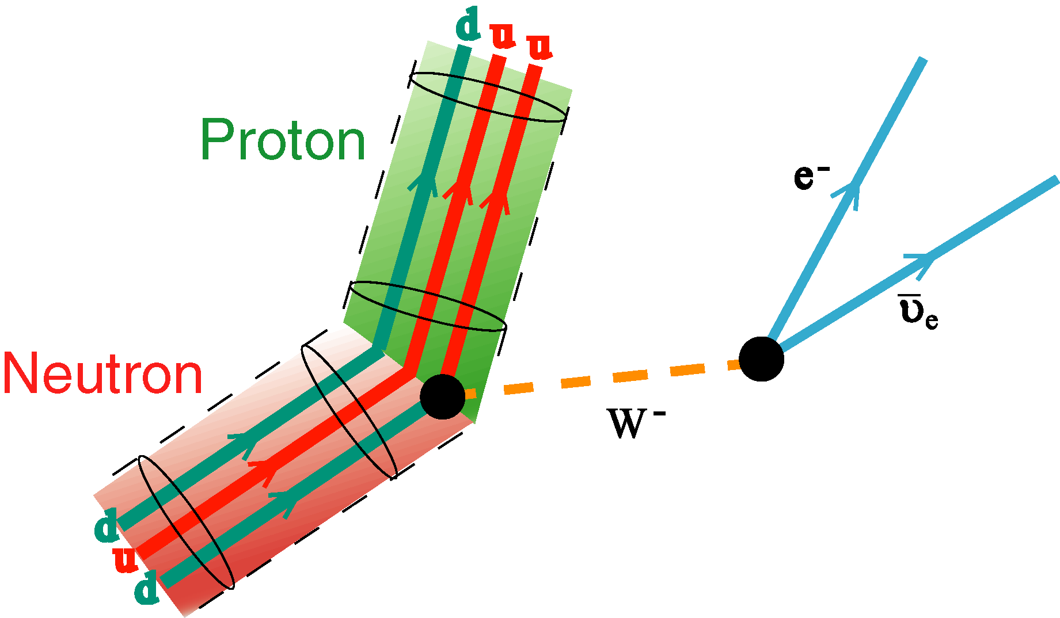
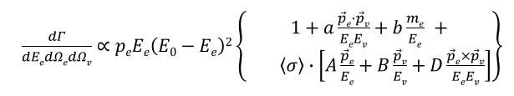

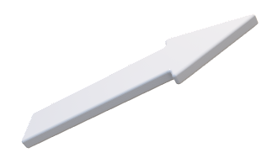

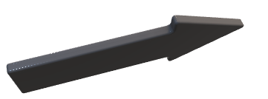
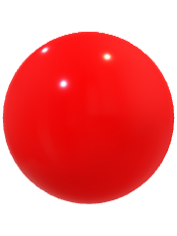
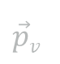
Angular Correlations
p_{e}
J
$$\vec{p}v$$
p_{p}
1

Slide 4
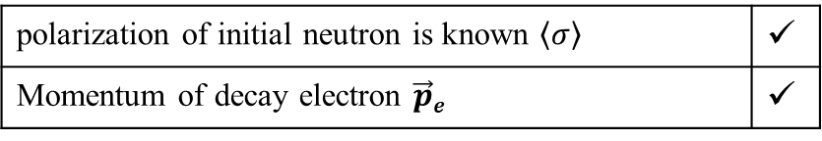
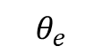
Angular Correlations
p_{e}
J
$$θ_{e}$$
$$\vec{p}v$$
p_{p}
polarization of initial neutron is known $\left\langle σ\right\rangle$ | ✓
Momentum of decay electron $\vec{p}e$ | ✓
1

Slide 5

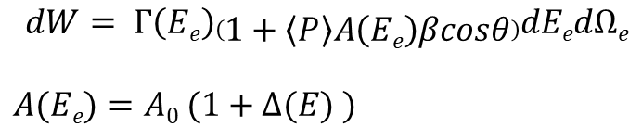
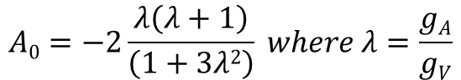
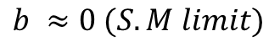
Angular Correlations
p_{e}
J
$$θ_{e}$$
$$\vec{p}v$$
$$b ≈0 (S.M limit)$$
p_{p}
polarization of initial neutron is known $\left\langle σ\right\rangle$ | ✓
Momentum of decay electron $\vec{p}e$ | ✓
$$dW= Γ\left(Ee\right)\left(1+\left\langle P\right\rangle A\left(Ee\right)βcosθ\right)dEedΩe$$
$$A(Ee)=A0 (1+Δ(E) )$$
$$A0=−2\frac{λ\left(λ+1\right)}{\left(1+3λ2\right)} where λ=\frac{gA}{gV}$$
1

Slide 6
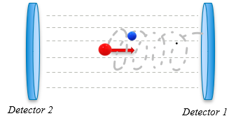
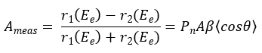
Angular Correlations
p_{e}
J
$$θ_{e}$$
$$\vec{p}v$$
p_{p}
polarization of initial neutron is known $\left\langle σ\right\rangle$ | ✓
Momentum of decay electron $\vec{p}e$ | ✓
$$dW= Γ\left(Ee\right)\left(1+\left\langle P\right\rangle A\left(Ee\right)βcosθ\right)dEedΩe$$
$$A(Ee)=A0 (1+Δ(E) )$$
$$A0=−2\frac{λ\left(λ+1\right)}{\left(1+3λ2\right)} where λ=\frac{gA}{gV}$$
1

Slide 7
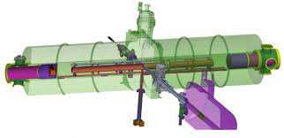
Measurement UCNA
Spectrometer
Magnetic Field 1 T
MWPC
Thin foil
Scintillator detector
in magnetic field expansion region at B_{z} = 0.6 T
Fig : Schematic representation of UCNA setup
2
Notes:
Mention the ddetector was placed at 0.6 T in the magnetic field expansion region

Slide 8
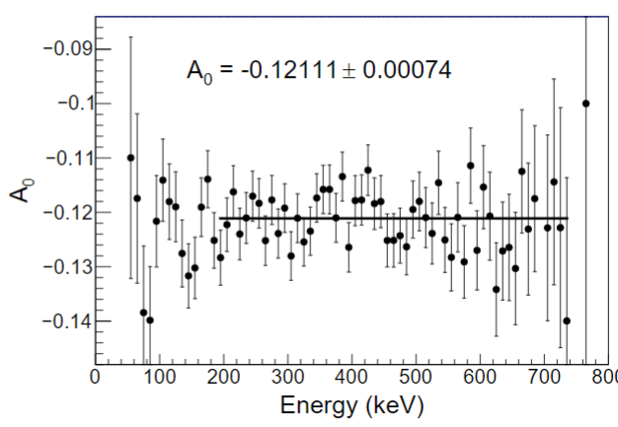
Measurement UCNA
Spectrometer
Magnetic Field 1 T
MWPC
Thin foil
M. Brown Phys.Rev.C 97 (2018)
Scintillator detector
in magnetic field expansion region
Fig : Asymmetry result by UCNA – 2018 with uncertainty $δA/A$ = 0.6% [ Phys.Rev.C 97 (2018)]
Fig : Schematic representation of UCNA setup
2
Notes:
Mention the ddetector was placed at 0.6 T in the magnetic field expansion region

Slide 9
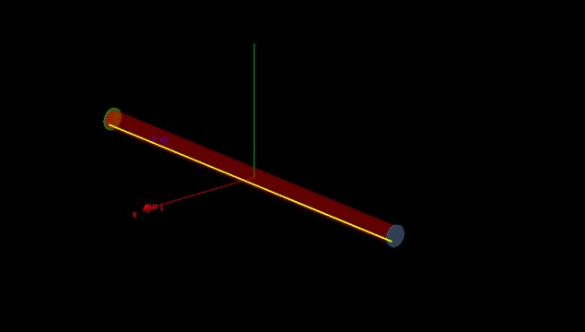

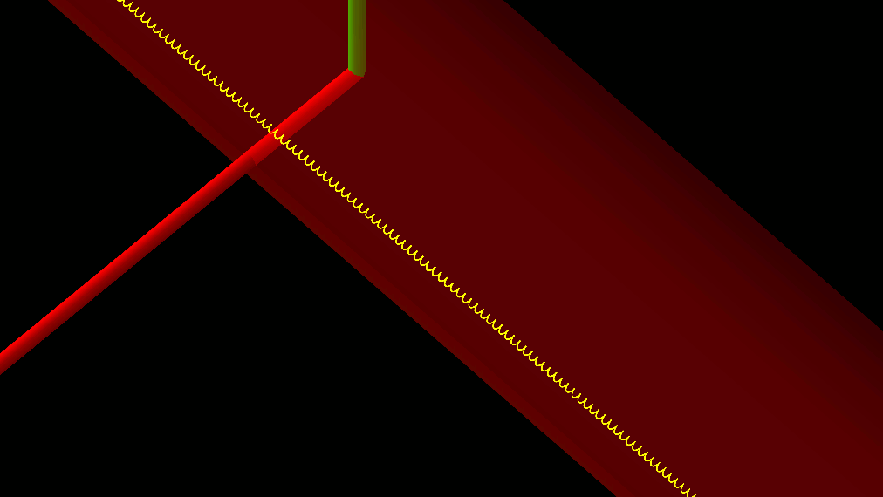
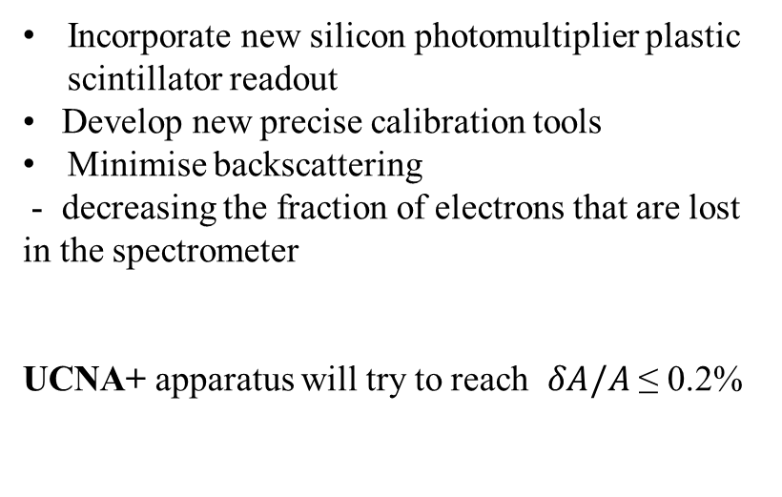
From UCNA to UCNA +
see Dr. Pattie’s talk on Friday
Incorporate new silicon photomultiplier plastic scintillator readout
• Develop new precise calibration tools
Minimise backscattering
- decreasing the fraction of electrons that are lost in the spectrometer
UCNA+ apparatus will try to reach $δA/A$ ≤ 0.2%
Fig : Geant4 simulations representation for UCNA+ experiment
3

Slide 10
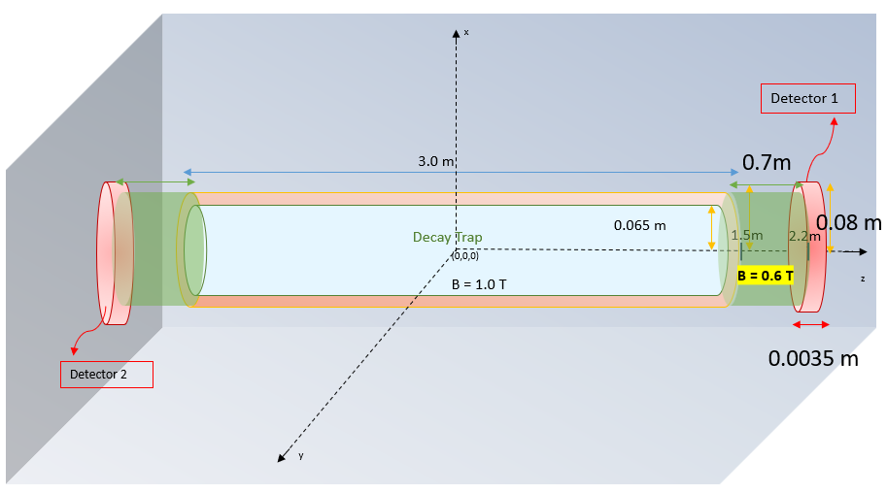
UCNA + Geant4 setup
No decay trap foil
No MWPC
Fig : Geant4 simulations representation for base setup of UCNA+ experiment
2 Rashika Gupta
4
Notes:
This is the base setup
Check how the magentic field lines would look like

Slide 11

UCNA + Geant4 simulation
Neutron spin aligned along +z direction in the simulations
J
Detector 2
(-z)
Detector 1
(+z)
Fig : Geant4 simulations representation for UCNA+ experiment
2 Rashika Gupta
5

Slide 12


UCNA + Geant4 simulation
Neutron spin aligned along +z direction in the simulations
TYPE 0 : Direct Events
Detector 2
(-z)
Detector 1
(+z)
Fig : Geant4 simulations representation for UCNA+ experiment
2 Rashika Gupta
5

Slide 13

UCNA + Geant4 simulation
Neutron spin aligned along +z direction in the simulations
TYPE 0 : Direct Events
TYPE 1 : Backscattered Events
Detector 2
(-z)
Detector 1
(+z)
Fig : Geant4 simulations representation for UCNA+ experiment
2 Rashika Gupta
5

Slide 14
Detectors moved through magnetic field expansion

Slide 15
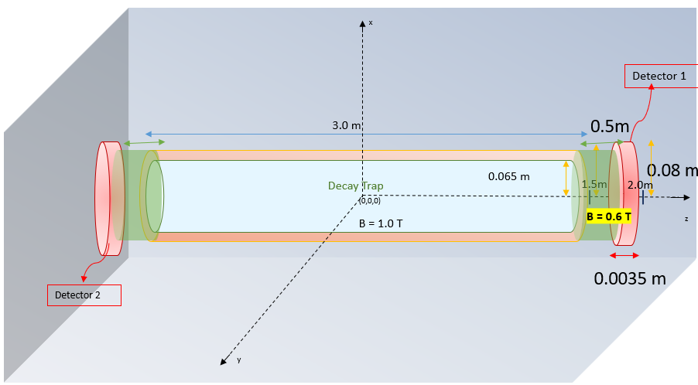
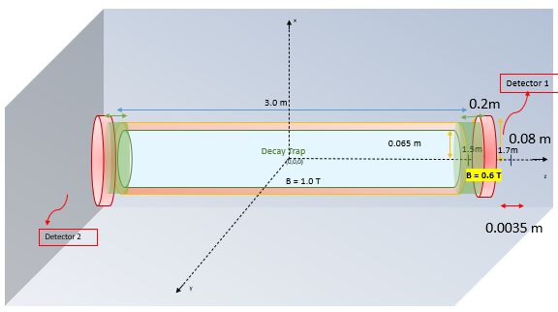
B = 0.9T
Fig : Geant4 simulations representation for UCNA+ experiment
2 Rashika Gupta
6

Slide 16
B = 0.7T
Fig : Geant4 simulations representation for UCNA+ experiment
2 Rashika Gupta
6

Slide 17
Fig : Geant4 simulations representation for UCNA+ experiment
2 Rashika Gupta
6

Slide 18
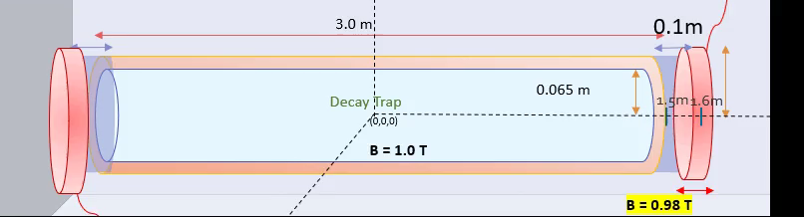
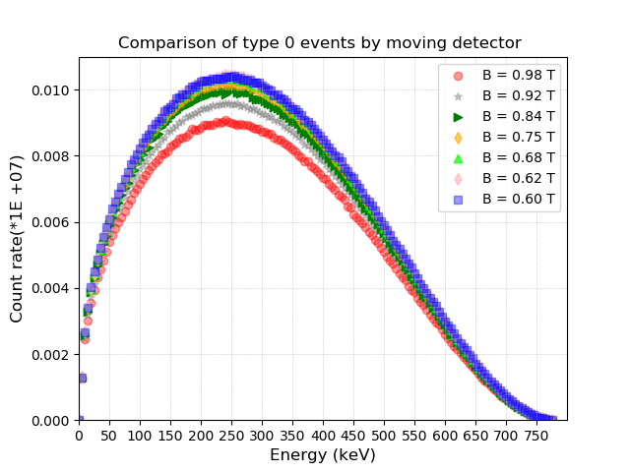
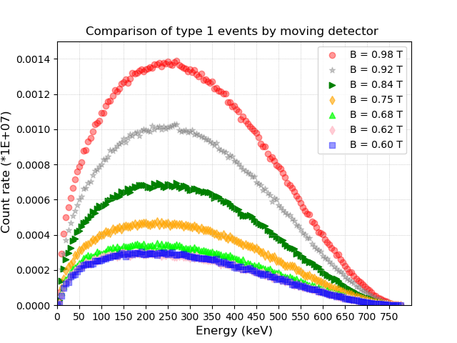
Reconstructed neutron beta spectra
Fig : Comparison of Type 0 and Type 1 events for neutron beta decay in the UCNA+ Geant4 setup. The different spectra corresponds to energy deposited in the detector when moved through field expansion region
7

Slide 19
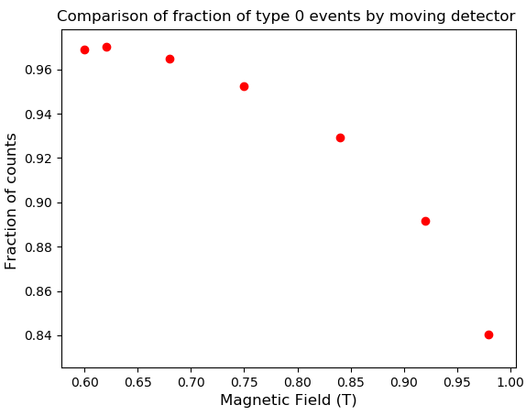
Change in fraction of Type 0 events
maximum when detector is placed at B_{z} = 0.6 T
Fig : Comparison of fraction of Type 0 and Type 1 events for neutron beta decay in the UCNA+ Geant4 setup when detector is moved through different field region.
8

Slide 20
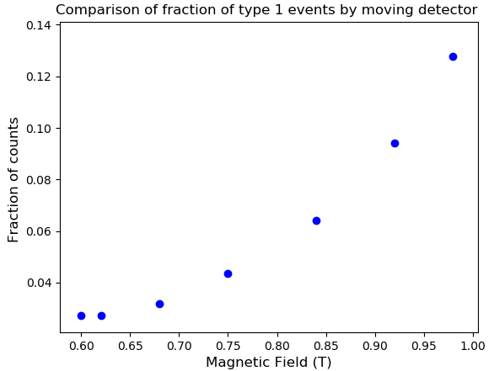
Change in fraction of Type 0 and Backscattered events
minimum back-scattering and maximum Type 0 events when detector is placed at B_{z} = 0.6T
Fig : Comparison of fraction of Type 0 and Type 1 events for neutron beta decay in the UCNA+ Geant4 setup when detector is moved through different field region.
8

Slide 21
Different thin foil configurations
- Change in fraction of backscattering
- Angle and energy dependence for conversion electron from ¹¹³Sn

Slide 22
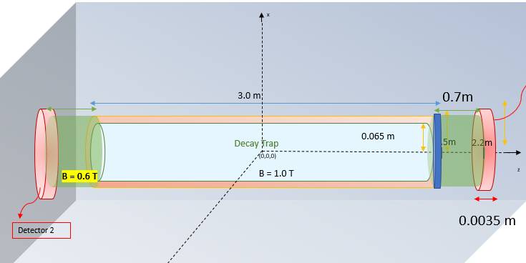
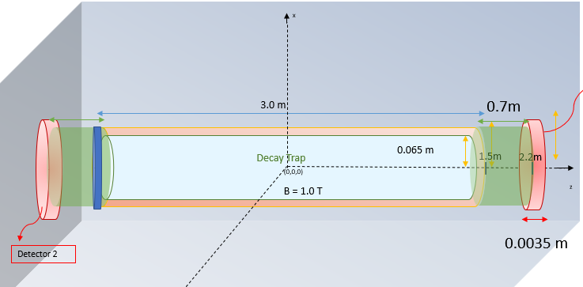
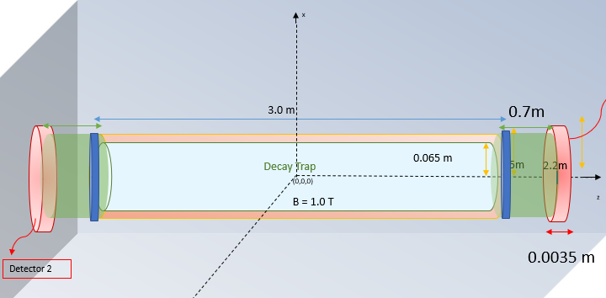


Foil at +z only
Foil at -z only
Foil on both ends
J
made of mylar C₆F₆of thickness 130 nm
Neutron spin aligned along +z
Fig : Geant4 simulations representation for UCNA+ experiment
9
Notes:
For a neutron with spin polarized +z axis emits electron preferably along –z axis

Slide 23
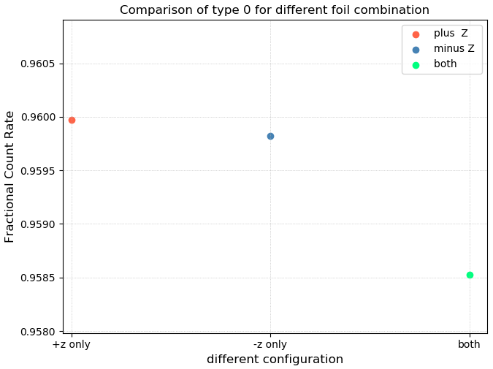
Change in fraction of Type 0 and dead events
Neutron spin aligned along +z
maximum fraction of Type 0 events when thin foil is at +z only
Fig : Comparison of fraction of Type 0 events and dead events for neutron beta decay in the UCNA+ Geant4 setup for different foil configuration
10

Slide 24
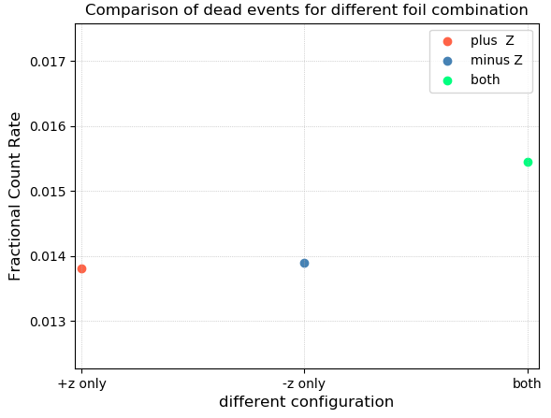
Change in fraction of Type 0 and dead events
maximum fraction of Type 0 events when thin foil is at +z only
Maximum dead events when foils on both the sides
Fig : Comparison of fraction of Type 0 events and dead events for neutron beta decay in the UCNA+ Geant4 setup for different foil configuration
10

Slide 25
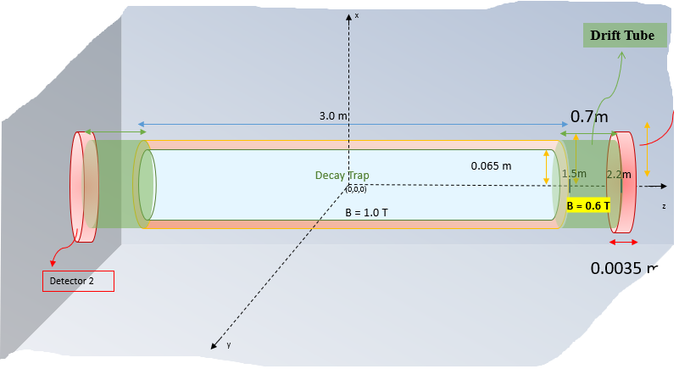
Geant4 simulations results for ¹¹³Sn electron conversion
0 Foil
1 Foil
Fig : Geant4 simulations representation for UCNA+ experiment
11
Notes:
All the above analysis was carried out for energy dependent spectra. For detector to introduce no biasness lets look what happens when we have an isotropic emission of electrons at fixed initial energy for which we use 113sn

Slide 26
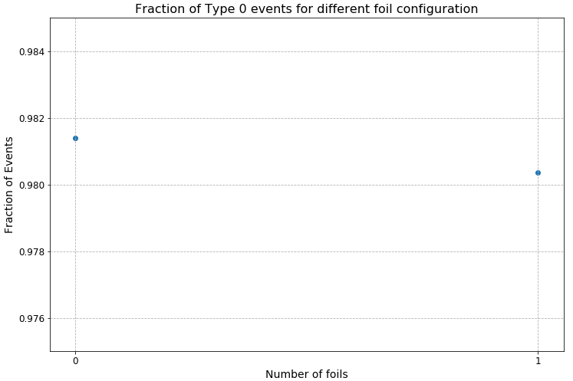
Change in fraction of Type 0 and Type 1 events
maximum fraction of Type 0 events when there is no foil !
Fig : Comparison of fraction of Type 0 and dead events ¹¹³Sn in the UCNA+ Geant4 setup for different foil configuration
12

Slide 27
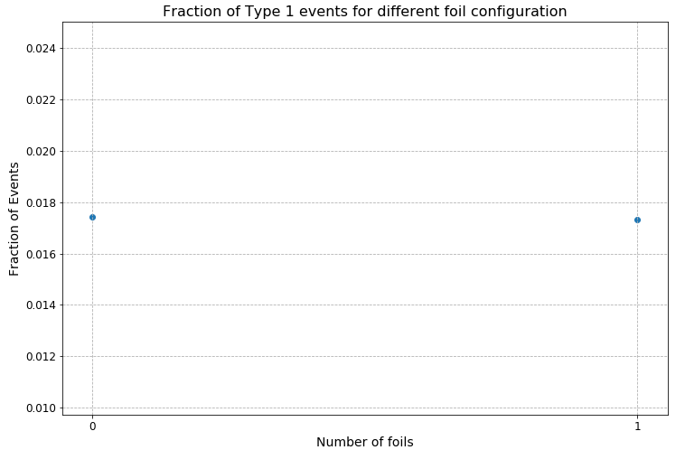
Change in fraction of Type 0 and Type 1 events
maximum fraction of Type 0 events when there is no foil !
Maximum Backscattering when there are foils on both ends
Fig : Comparison of fraction of Type 0 and dead events ¹¹³Sn in the UCNA+ Geant4 setup for different foil configuration
12

Slide 28
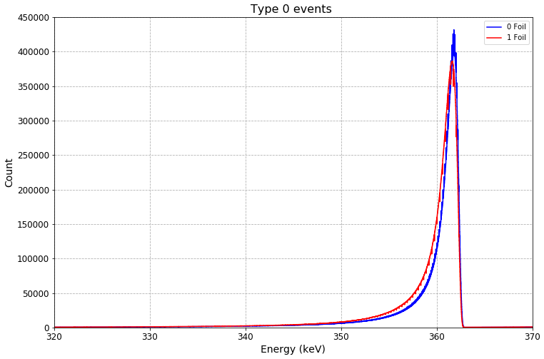
Geant4 simulations results for ¹¹³Sn electron conversion
0 Foil
1 Foil
Indicating angular dependence of emitted electron
Fig : Geant4 simulations representation for UCNA+ experiment
13
Notes:
To continue building a realistic model of the detector we must study the angle dependent effects.

Slide 29
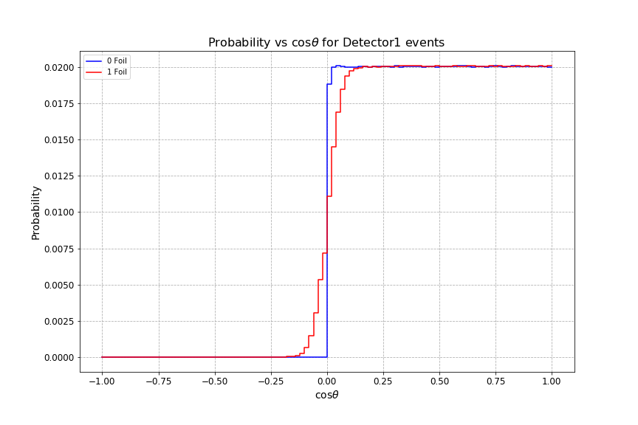
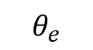

Angular dependent effects
$$θ_{e}$$
density
Detector 2
(-z)
Detector 1
(+z)
For single foil configuration we notice multiple scattering
Fig: Probability distribution with which angle electron is emitted for the events that are detected by detector 1 first.
14
Notes:
Let’s look at the probability of the detection of electron emitted in the direction of the detector 1

Slide 30
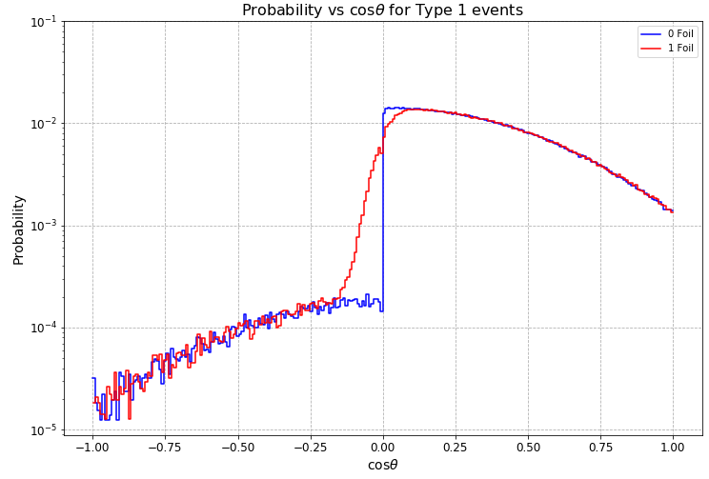
Angular dependent effects
For single foil configuration we notice multiple scattering
WHEN DETECTOR 1 (+Z) GETS HIT FIRST
density
density
Fig: Probability distribution with which angle electron is emitted for the events that are detected by detector 1 first.
Fig: Probability distribution of the angle with which electron is emitted for the Type 1 events that are detected by detector 1 first.
14
Notes:
the angular distribution of event backscattering from the foils is sharply peaked at larger angles or small cos theta

Slide 31
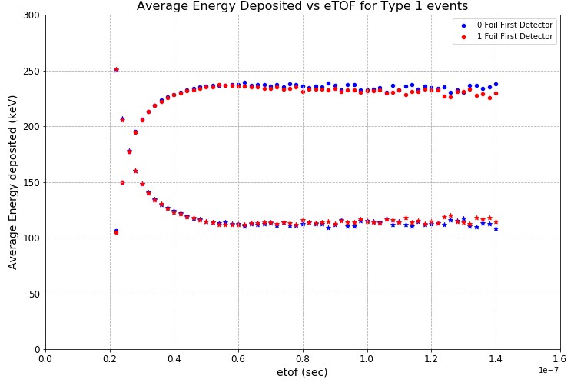
Change in angular and energy deposition
For single foil configuration lesser energy deposition in first detector for longer time of flight
WHEN DETECTOR 1 (+Z) GETS HIT FIRST
Fig : Average energy deposited in the detector vs time of flight for backscattered events when detector 1 hits first . Energy deposited in detector 1 is given by • and in detector 2 by Δ
15
Notes:
A more sensitive test of the angular distribution of the backscattered events is to compare the average total visible energy with the time of flight between the detectors.
. The simulation predicts that mean energy will be rapidly changing over the first 10 ns before reaching a constant value,
Therefore the bulk of the spread in the observed time of flight spectrum can be correlated to the angular distribution of emission of electrons
. It is interesting to note that after20 ns,tcs<110ns, events tend to deposit an equal amount of energy in both detectors, a trend whichappears to be independent of the foil thickness.

Slide 32
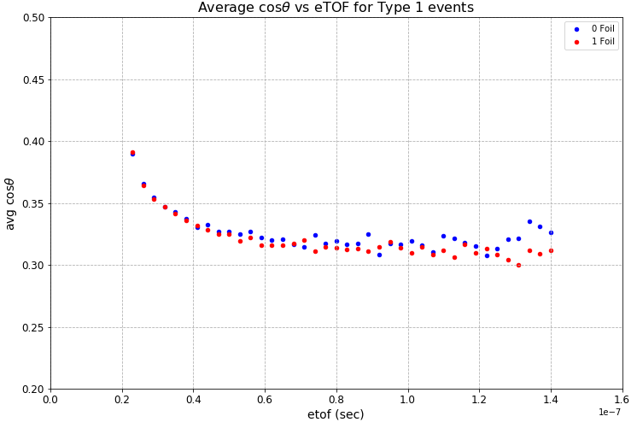
Change in angular and energy deposition
For single foil configuration lesser energy deposition in first detector for longer time of flight
larger average emission angle
WHEN DETECTOR 1 (+Z) GETS HIT FIRST
Fig : Average energy deposited in the detector vs time of flight for backscattered events when detector 1 hits first . Energy deposited in detector 1 is given by • and in detector 2 by Δ
Fig : initial Cos(theta) vs time of flight for backscattered events when detector 1 hits first
15

Slide 33
Conclusion
Working Geant4 model to calibrate the simulations for different detector geometries
Developed Geant4 to investigate the back-scattering and angular effect in experiment
strong correlation between back-scattering and angle of emission of electrons was observed.
Investigated the dependence of energy deposited in the first detector versus TOF as well as to the initial energy with and without the foils.
Notes:
, the probability for backscatteringfrom the decay trap foils and triggering the wrong detector is sharply peaked at grazing incidence, with95%of these events having an initial pitch angle w.r.t. the neutron spin ofθ>80° From this timing spectrum we can investigate correlations suchas the energy deposited in the first and second detector versus TOF, as well as the relation to the initialenergy, shown in Figure 3.15(b). The difference intT OFdue to the energy of backscattering electrons ison the order of 10 ns,∼26ns at 100 keV and∼15ns at 800 keV for a direct trajectory, therefore thelong tail of the timing distribution is related to the angle w.r.t to the field. It is interesting to note that after20 ns,tcs<110ns, events tend to deposit an equal amount of energy in both detectors, a trend whichappears to be independent of the foil thickness.

Slide 34
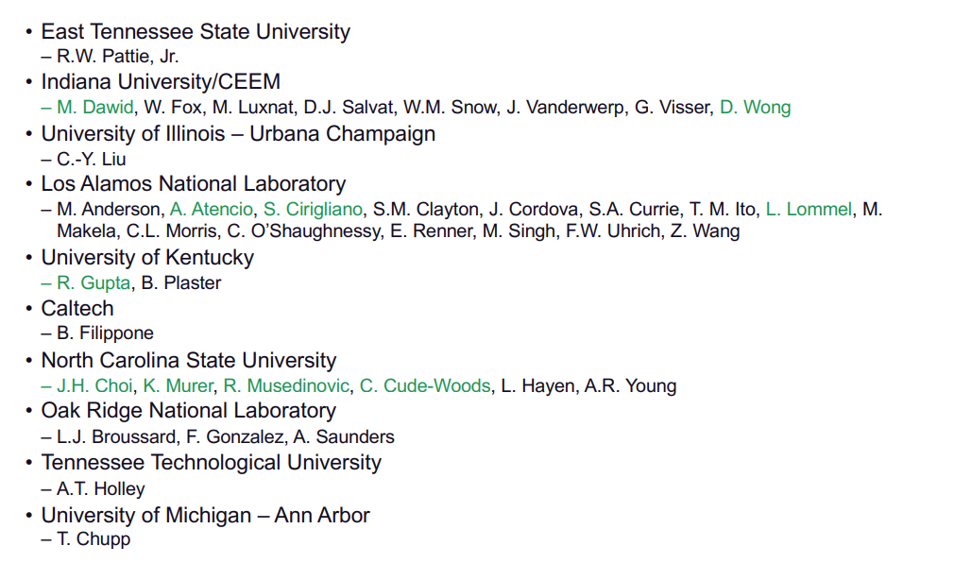
UCNA+ collaboration
*This material is based upon work supported by the U.S. Department of Energy, Office of Science,
Office of Nuclear Physics, under Award Number DE-SC0 014622

